Slide 1
LEGO TOYs MADE USING 3-D Printing technology
SNIGDH SINGH

Slide 2
INTRODUCTION
Lego Toys/ Block toys
Normal children of age group 3-5 years
Mentally-retarded children of age group 5-10 years
Non-Toxic, Customizable, Simple
Non-Toxic, Colorful, Indulging

Slide 4
NOVELTY
Non-Toxic : Without lead and arsenic
3D- Printing : Modern and Innovative technique
Injection Moulding : Creative design

Slide 5
3-D PRINTING MACHINE AND PRODUCT OUTCOME

Slide 6
CREATIVITY
Replacing PVC (Polyvinyl Chloride) with ABS (Acrylonitrile Butadiene Styrene)
More durable and stronger than plastic
Multiple colors with no lead content

Slide 7
CREATIVITY
Some companies use lead for printing which can cause high blood pressure, increased risk of blood pressure and even kidney damage in some cases.
Many countries like US have banned the use of lead. It was used in the paint of toys.
Lead is invisible to the naked eye and small children when they put the toys in their mouth they get exposed to it.
Our paint will have anti-lead pigments.
We will not use PVC i.e Poly Vinyl Chloride like it contains lead, cadmium and organizations that is poisonous.
Instead we can use ABS i.e Acrylonitrile Butadiene Styrene and Acrylic plastic that have same properties as ABS and are really safe and more durable.

Slide 8
And for really small parts we will be using 3D printing and for bigger part we will be using moulding processes.
The fibre used in 3D printers is ABS, Nylon fibre ,
Carbon fibres etc.
The fibres are available in really bright colours and really durable and strong.
By seeing the visuals and hearing the instructions the child without the help of anyone can play with the toy this enhances his/her self-learning.

Slide 9
REALISTIC IDEA
3-D Printing
Automatic and Error Free
Economically Feasible
One time capital investment
Need of the hour
Parents prefer to buy non-toxic toys
Environmental Impact
Zero Lead content

Slide 10
REALISTIC IDEA
We introduced two terms before: Moulding and 3D printing.
These two techniques are being used for many products so this is not any virtual concept rather it is the idea based on technology that already exist.
3D printer operates on codes given through a software these are called G-codes. For example: G92 to set position, G0 and G1 to move etc.
Another positive thing about 3D printing is that it is an automatic process. You just need to provide the instructions to the machine and your product will be ready overnight.

Slide 11
For moulding basically injection moulding is widely used. Using this wide variety of products of different shapes can be manufactured.
Moulding equipments and printers doesn’t require much maintenance, so basically this would be an one time investment in the setup and then you are ready to go.
When it comes to the demands of their children, parents are ready to invest so we hope of good sales too.
The cost for 3D printer ink and the plastic for moulding operation lies between 20-25 USD per kg so that is not too much.

Slide 12
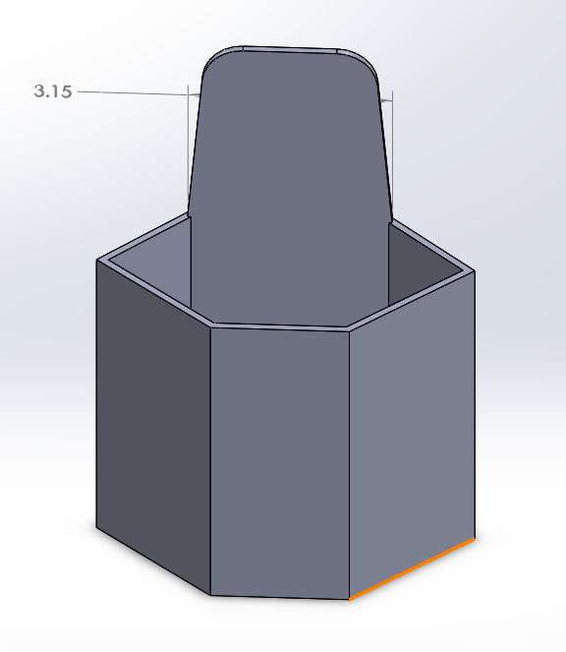
PROTOTYPE

Slide 13
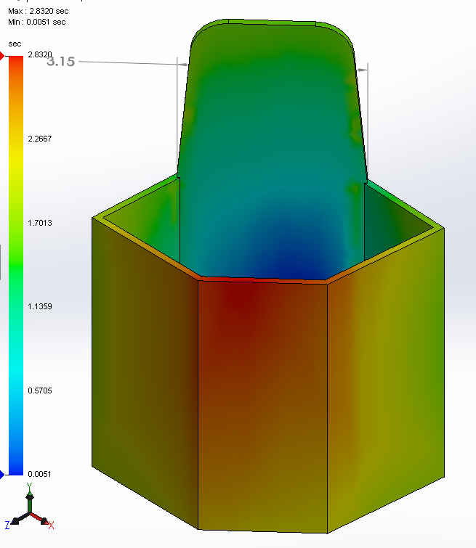
PROTOTYPE

Slide 14
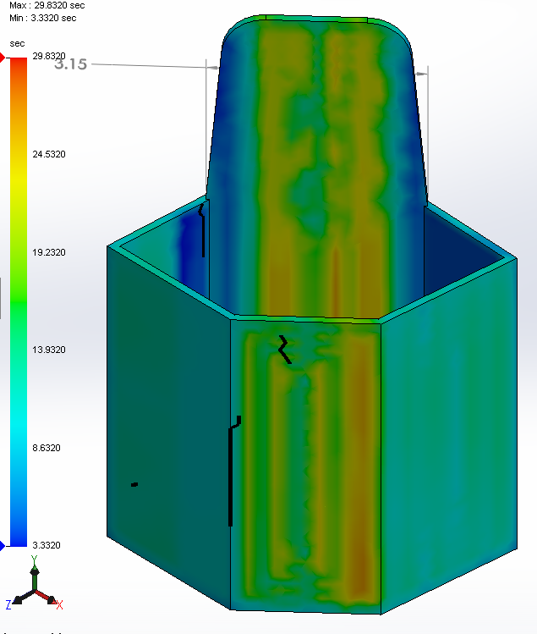
PROTOTYPE

Slide 15
Value ADDITION FOR CUSTOMER and STAKEHOLDER
Better Product
Non-Toxic- No Lead and PVC
Increase durability using ABS
MNC and Schools
Corporate social responsibility
High in demand by parents
Charity Trust
Social Cause
E.g. Gates foundation
High tensile strength upto 28.5 MPa
Huge scope of future market expansion

Slide 16
RISK MANAGEMENT- Identification, prioritization and RISK MAPING
Skilled labor : High priority and 90% probability
Damage: Disruption of manufacturing
Mitigate by Special Training
Cost factor : High priority and 40% Probability
Damage: Low return on investment
Mitigate by One-time investment
Investment into new technology : Low Priority and 30% Probability
Damage: Less or no investors
Eliminate by Spread Awareness
Competitors : Low Priority and 20% Probability
Damage: Low market share
Eliminate by IP filing
Managed by operations manager
Managed by operations manager
Managed by technical officer
Managed by marketing manager

Slide 17
ELABORATION OF HYPOTHESIS
Attractive look and creative design
Premium quality
Negative hypothesis
Outsourcing of skilled workers
Cost intensive manufacturing
Positive Hypothesis
Eco friendly
Scarcity of raw material

Slide 18
CUSTOMER JOURNEY MAP
AWARENESS OF NEED
Advertisement at most widely used public transport stations
EVALUATION OF SEARCH OPTIONS
Product sample distribution at kids school
Return policy within 1 month
USER EXPERIENCE
SMS on their registered mobile numbers and email
Social media tags, Example- Instagram
Promotional events at amusement parks
PURCHASE PROCESS
Cash on delivery
E-commerce/ offline stores

Slide 19
FINANCIAL & BUSINESS MODEL
FIXED COST
Cost of 3-D Printer
Cost of Moulding equipment
INDIRECT COST
Rent paid towards office and industry workspace
Taxes to be paid
VARIABLE COST
DIRECT COST
Wages paid to skilled workers
Material used for manufacturing
Material cost
Maintenance and repairs
Purchasing and maintenance cost of printer and moulding equipment
Amortization cost

Slide 20
THANK YOU

